Slide 1
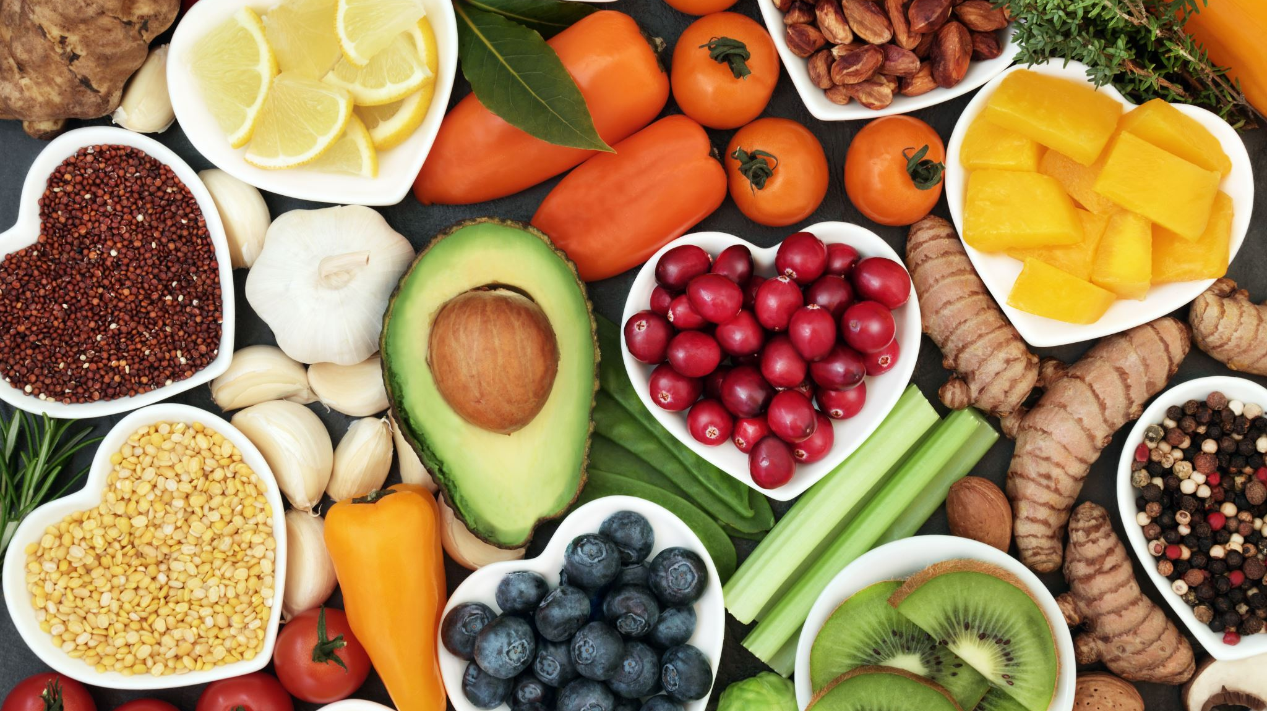
Calorie Counter
By:
Faygie Fruchthandler
Etty Tepper
Aliza Peikes
Aliza Fried

Slide 2
OUR VISION: To create a quick and user-friendly way for people to track their daily calorie intake. Science has proven that all humans need calories, or energy, to operate. However, when we consume more calories than we need, those calories get converted to fat. With our application, users can easily see how many calories they’ve eaten that day and how many more they can still consume. Through this, we help the users ensure that they don’t go over their daily calorie allowance.

Slide 3
User’s journey
Enter personal information
1
Choose a diet plan
2
Track calorie intake
3
Create a list of favorite foods
4

Slide 4

Personal Information User inputs basic information:
1
Enter personal information
Name
Age
Height
Weight
Gender
Standard Exercise

Slide 5
Personal Information
Once we have the user’s profile, we calculate his BMI and BMR

Slide 6
BMR is the rate at which your body burns calories through involuntary activities.
Formula is based on Height, Weight, and Gender
Male: BMR = 66 + (6.23 * weight) + (12.7 * height) - (6.8 * age)
Female: MR = 665 + (4.35 * weight) + (4.7 * height) - (4.7 * age)
We used BMR to determine the amount of calories a person needs to maintain their daily activities.
The BMI is derived from the body mass, or weight, and the height of a person. It determines whether a person is at a healthy weight
We implement the formula with the user’s height and weight and calculate his BMI
Formula is based on height and weight
BMI= weight (lb) / [height (in)]² x 703
Together with BMR and exercise, we used BMI to evaluate a recommended diet plan.

Slide 7
Personal Information BMR – Basel Metabolic Rate
BMR is the rate at which the body burns calories through involuntary activities.
The formula to calculate BMR varies depending on gender
Male: BMR = 66 + (6.23 * weight) + (12.7 * height) - (6.8 * age)
Female: BMR = 665 + (4.35 * weight) + (4.7 * height) - (4.7 * age)
We implement this formula using the user’s weight, height, age and gender.
We then apply the BMR to determine the amount of calories the user needs to maintain his daily activities.

Slide 8
Personal Information BMI – Body Mass Index
The BMI is derived from the body mass, or weight, and the height of a person. It determines whether a person is at a healthy weight
This is the formula: BMI= weight (lb) / [height (in)]² x 703
We implement the formula with the user’s height and weight and calculate his BMI

Slide 9
Personal Information
We then take the BMR, BMI, and standard exercise and produce a recommended diet plan.

Slide 10

Choose a Diet Plan Next, the user chooses a diet plan
2
Choose a diet plan

Slide 11
Choose a Diet Plan
The four diet options
Weight Gain
Maintenance
Weight Loss
Extreme Weight Loss

Slide 12
Choose a Diet Plan
Based on the user’s profile, we tell him which diet we recommend and how many daily calories it allows.
The user, however can choose to go ahead with any of the other diet options.
Once the user chooses, we set his daily calorie goal

Slide 13
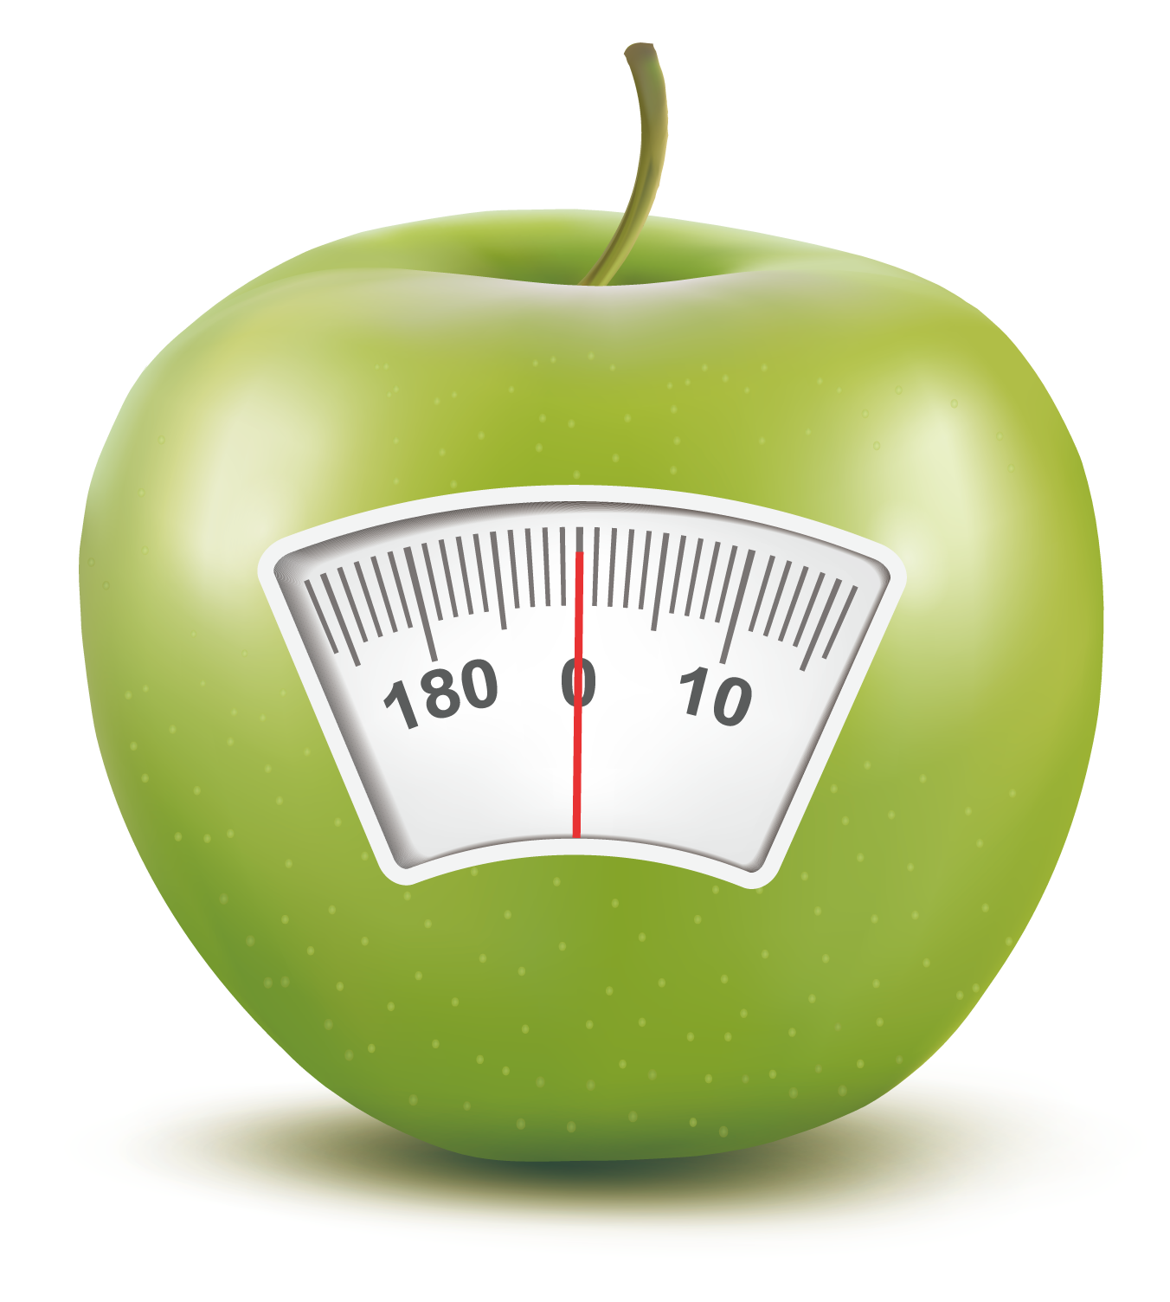
Track Calorie Intake Now the user can start tracking his calorie intake
3
Track calorie intake
Options
Add Calorie Intake
Check Calorie Count

Slide 14
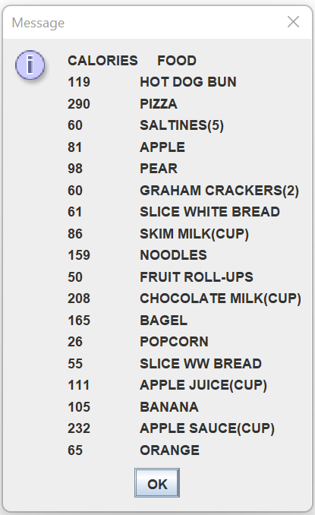
Track Calorie Intake
Add Calories:
Numerical calorie amount
Name of a food from a list of staples
User has the option to add a commonly eaten food to the list

Slide 15
Track Calorie Intake
Check Calorie amount

Slide 16

Feedback
Thank you for listening
We would love to hear your feedback at:
feedback@caloriecounter.com

